Slide 1
Bachelor of Science (Civil/Structural Engineering)
BXX004C Industrial Design (BCS) Workshop
Building Information Modelling (BIM)
and the use of Autodesk Revit
Karoline Figueiredo

Slide 2
Agenda
Day 1 – Nov, 30
BIM: concept, its importance for civil engineering and its advantages
Knowing the Revit interface
Revit Families and Revit Template
Day 2 – Dec, 01
Architectural modelling
Most important modelling tools
Case study development from start to finish
Building Information Modelling (BIM)
and the use of
Autodesk Revit
Day 3 – Dec, 02
Project Documentation
Possibility of Analysis and Simulations
Printing your Views and Sheets

Slide 3
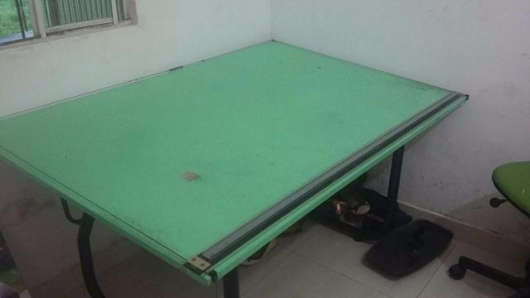
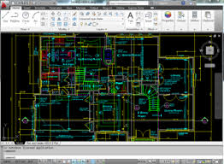
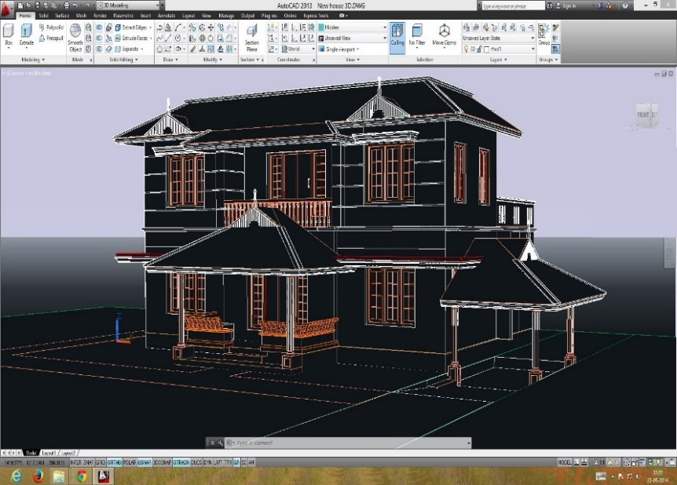
Historical Evolution

Slide 4
Historical Evolution
1957
2000
Dr. Patrick J. Hanratty, known as the "Father of CAD”, wrote Pronto, an early commercial numerical control programming language
Revit, a building information modelling software for AEC Industry professionals, was launched
1982
2002
Autodesk launched AutoCAD, the first 2D design CAD software made for PCs instead of mainframe computers
Autodesk purchased Revit, which allowed more research, development and improvement of the software.

Slide 5
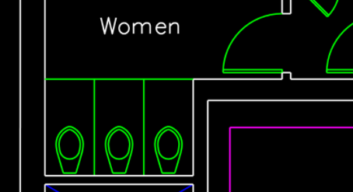
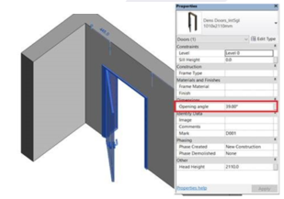
CAD vs. BIM
CAD – Computer Aided Design
BIM – Building Information Modelling
When creating CAD projects, be it architectural, engineering or installation design, you develop a virtual design through points and lines, being necessary to create one by one until you have all the elements for your project at the final level.
When creating BIM projects, you develop a 3-D digital model of the building that has available all the information necessary for graphic expression, constructive analysis, materials takeoff, costs and deadlines, and everything that is interesting for the project.

Slide 6
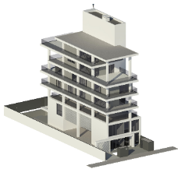
BIM Methodology
DESIGN AND VISUALIZATION
Test various types of solutions for buildings, have a complete spatial view, etc.
COLLABORATION AND COMPATIBILIZATION
QUANTIFICATION AND DOCUMENTATION
Multidisciplinary participation incorporated, where everyone has a global understanding of the project. Verification of model incompatibility, identifying overlaps, conflicts, errors and omissions.
Automatic and accurate quantification of materials, automated budget, documentation of all information, etc.

Slide 7
BIM Dimensions

Slide 8
The clear advantages of BIM solutions
Pre-Construction
During Construction
Post-Construction
Different project alternatives can be tested quickly;
Analysis of costs, human resources, energy, acoustics, lighting, impacts, etc;
Improvement in the decision-making process;
Work done collaboratively, without loss of information;
Design interference between disciplines corrected before construction.
Constantly monitor project progress in real-time;
Safer construction, with hazards predicted in advance;
If changes need to be made during the construction work, the project can be easily updated, and modifications can be tested on the digital model;
Use the BIM model linked to virtual reality to help monitor the work.
Project evaluation made quickly, as all information related to all phases of the project is centralized in the same digital model;
Decisions made in other phases can be audited, and lessons applied to future projects can be generated;
The BIM model can be fed with information regarding the use and maintenance of the building so that the digital model can be used as a tracking tool.

Slide 9
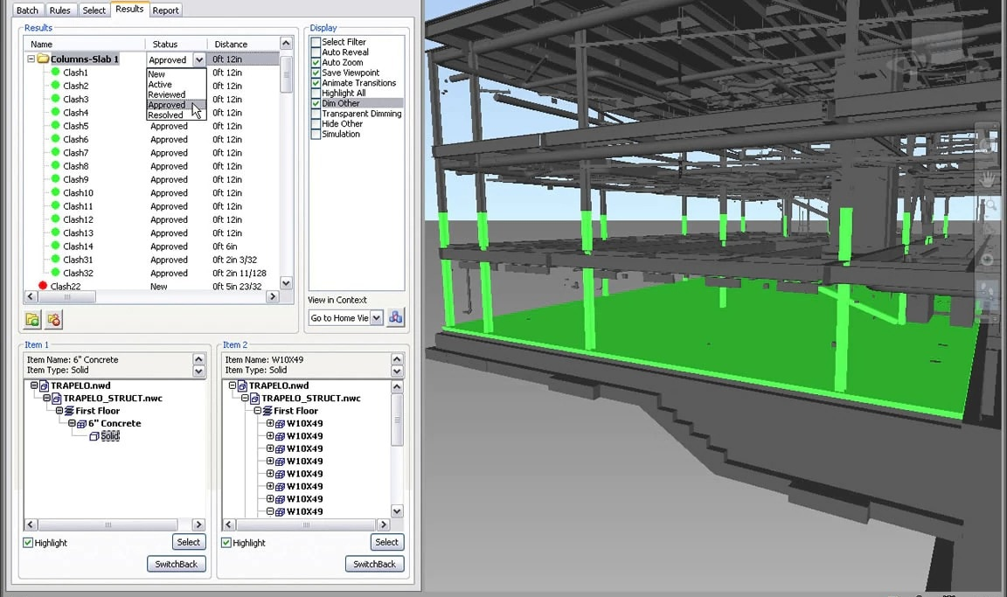
Projects Examples

Slide 10
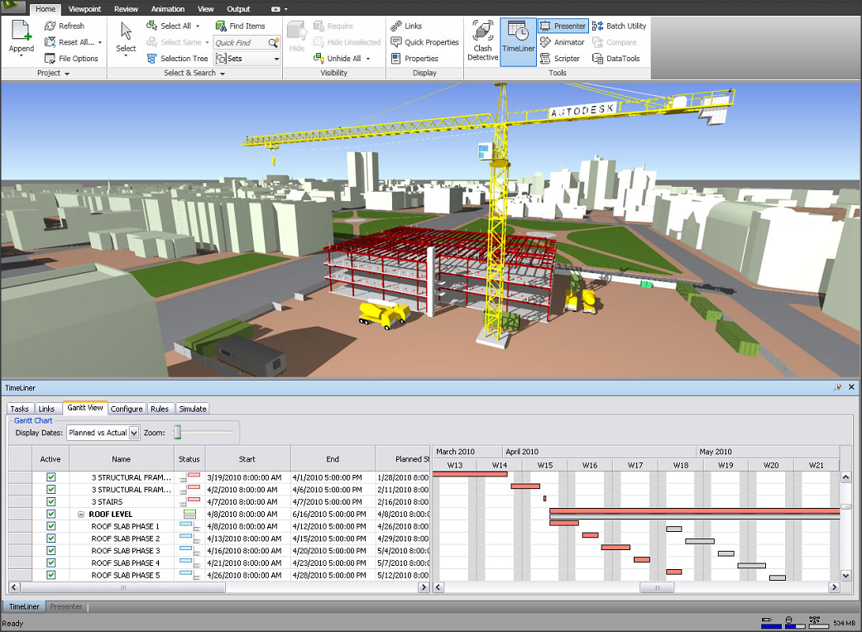
Projects Examples

Slide 11
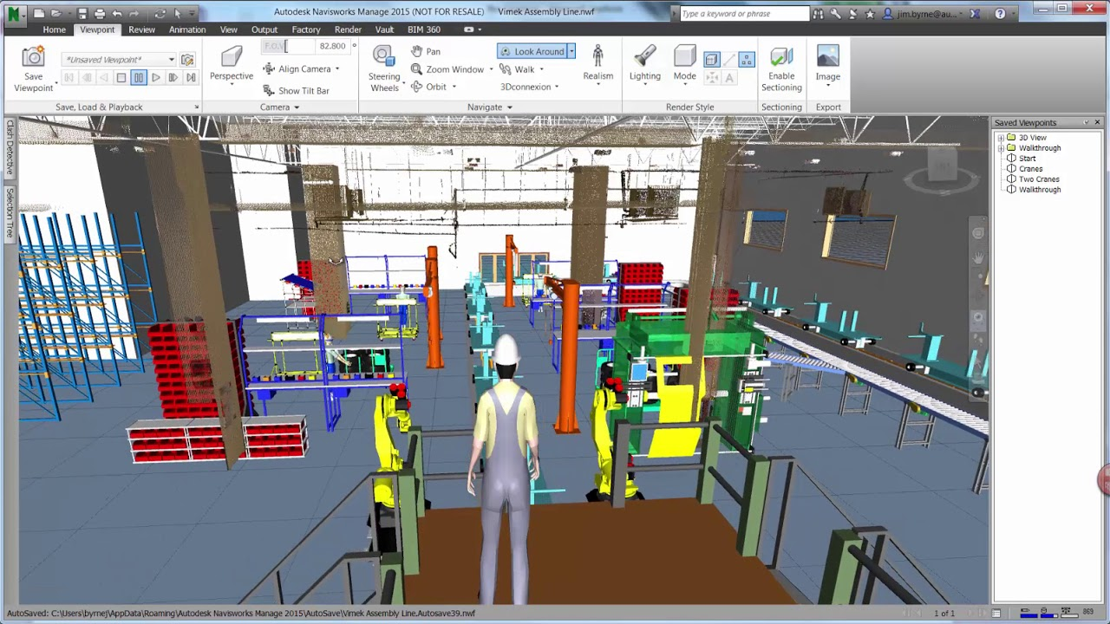
Projects Examples

Slide 12
Projects Examples

Slide 13
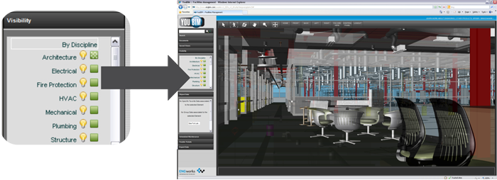
Projects Examples

Slide 14
References
Munir, M., Kiviniemi, A., Jones, S.W. and Finnegan, S. (2020), "The business value of BIM for asset owners: a cross-case analysis", Journal of Facilities Management, Vol. 18 No. 5, pp. 469-486. https://doi.org/10.1108/JFM-06-2020-0037
Hong, Y., Hammad, A.W.A., Sepasgozar, S. and Akbarnezhad, A. (2019), "BIM adoption model for small and medium construction organisations in Australia", Engineering, Construction and Architectural Management, Vol. 26 No. 2, pp. 154-183. https://doi.org/10.1108/ECAM-04-2017-0064
https://www.autodesk.com.br/products
https://www.createdigital.org.au/bim-can-be-a-game-changer-for-construction-industries/

Slide 15
Time to practice!
Let's start our project on Revit.

